Slide 1
CSE115
Lecture 5 & 6
Dr. Mohammad Abu Yousuf (MAY)

Slide 2
Input and Output

Slide 3
Scanf ()
scanf() is a library function declared in <stdio.h>
Input data can be entered into the computer from a standard input device by means of the C library function scanf.
This function can be used to enter any combination of numerical values, single characters and strings.
The scanf function is written as
scanf(contro1 string, argl, arg2, . . . , argn)
where control string refers to a string containing certain required formatting information, and argl, arg2, . . . argn are arguments that represent the individual input data items. The arguments are actually pointers that indicate where the data items are stored in the computer's memory.

Slide 4
Scanf ()
The control string consists of individual groups of characters, with one character group for each input data item. Each character group must begin with a percent sign (%).
In its simplest form, a single character group will consist of the percent sign, followed by a conversion character which indicates the type of the corresponding data item.
Each variable name must be preceded by an ampersand (&).

Slide 5
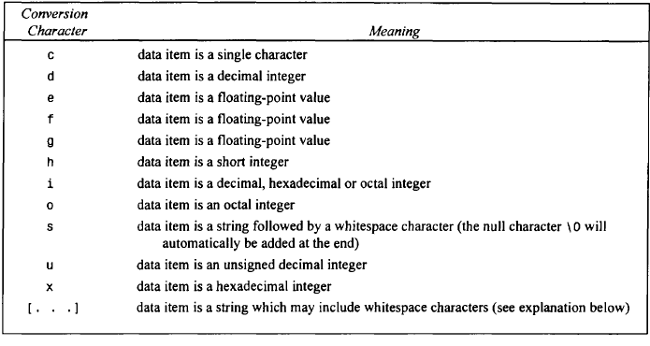
Scanf ()
Commonly Used Conversion Characters for Data Input

Slide 6
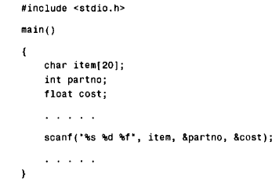
Within the scanf function, the control string is "%s %d %f " . It contains three character groups. The first character group, %s, indicates that the first argument (item) represents a string. The second character group, %d, indicates that the second argument (&partno) represents a decimal integer value, and the third character group, %f , indicates that the third argument (&cost) represents a floating-point value.
Notice that the numerical variables partno and cost are preceded by ampersands within the scanf function. An ampersand does not precede item, however, since item is an array name.

Slide 7
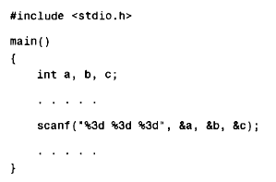
More on scanf()
Consider the C program

Slide 8
More on scanf()
When the program is executed, three integer quantities will be entered from the standard input device (the keyboard).
Suppose the input data items are entered as 1 2 3. Then the following assignments will result: a = 1 , b = 2 , c = 3
If the data had been entered as
123 456 789
Then the assignments would be
a = 123, b = 456, c = 789
Now suppose that the data had been entered as
123456789
Then the assignments would be
a = 123, b = 456, c = 789
as before, since the first three digits would be assigned to a, the next three digits to b, and the last three digits to c.

Slide 9
More on scanf()
Finally, suppose that the data had been entered as
1234 5678 9
The resulting assignments would now be
a = 123, b = 4, c = 567
The remaining two digits (8 and 9) would be ignored, unless they were read by a subsequent scanf statement.

Slide 10
Printf () Function
printf() is a library function declared in <stdio.h>
Output data can be written from the computer onto a standard output device using the library function p r i n t f .
That is, the printf function moves data from the computer’s memory to the standard output device, whereas the scanf function enters data from the standard input device and stores it in the computer’s memory.
In general terms, the p r i n t f function is written as
p r i n t f (control string, arg7, arg2, . . . , argn).
where control string refers to a string that contains formatting information, and arg7, arg2, . . . , argn are arguments that represent the individual output data items.

Slide 11
Printf () Function
The control string consists of individual groups of characters, with one character group for each output data item. Each character group must begin with a percent sign (%). In its simplest form, an individual character group will consist of the percent sign (%) , followed by a conversion character indicating the type of the corresponding data item

Slide 12
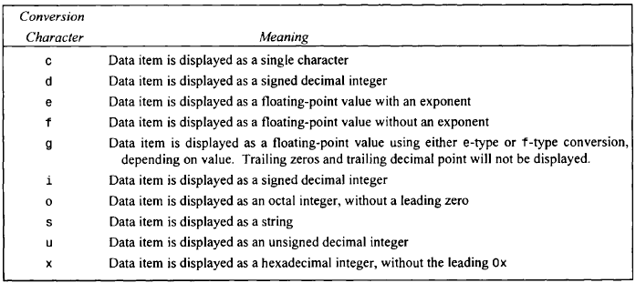
Printf () Function
Commonly used conversion character for data output

Slide 13
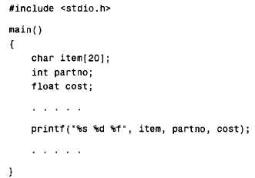
Within the printf function, the control string is "%s %d %f. It contains three character groups.
The first character group, %s, indicates that the first argument (item) represents a string.
The second character group, %d, indicates that the second argument (partno) represents a decimal integer value, and
The third character group, %f, indicates that the third argument (cost) represents a floating-point value.

Slide 14
Let’s Try !!!
A C program contains the following variable declarations.
float a = 2.5, b = 0.0005, c = 3000.;
Show the output resulting from each of the following printf statements.
(a) printf ( "%f %f %f",a, b, c);
(b) printf('%3f %3f %3f ", a, b, c);
(c) printf( “%8f %8f %8f", a, b, c);
(d) printf("%8.4f %8.4f %8.4f", a, b, c);
(e) printf("%8.3f %8.3f %8.3f", a, b, c);

